Slide 1
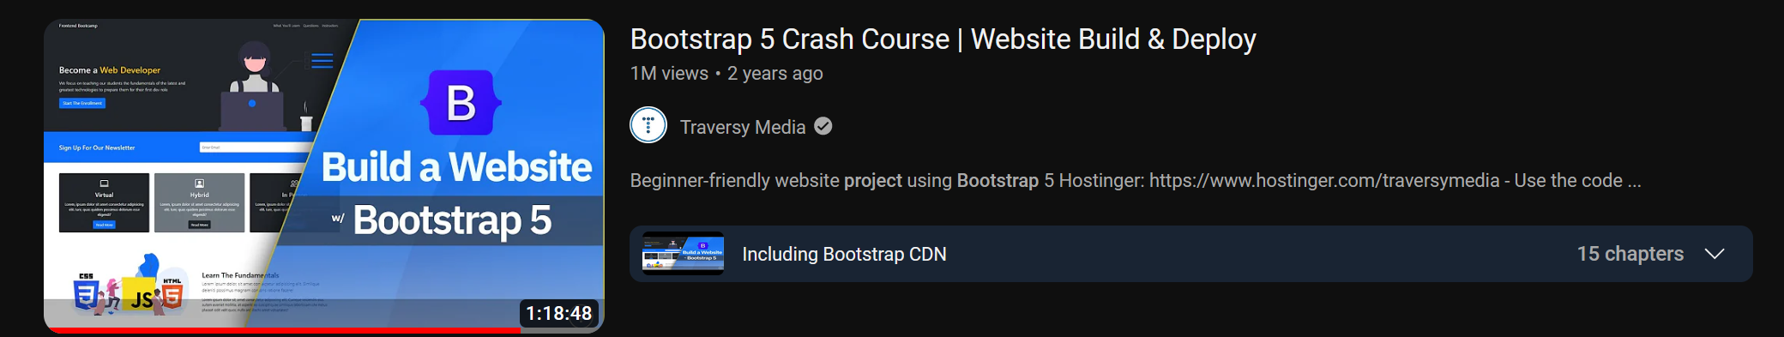
This Course is made by following this tutoruial

Slide 2
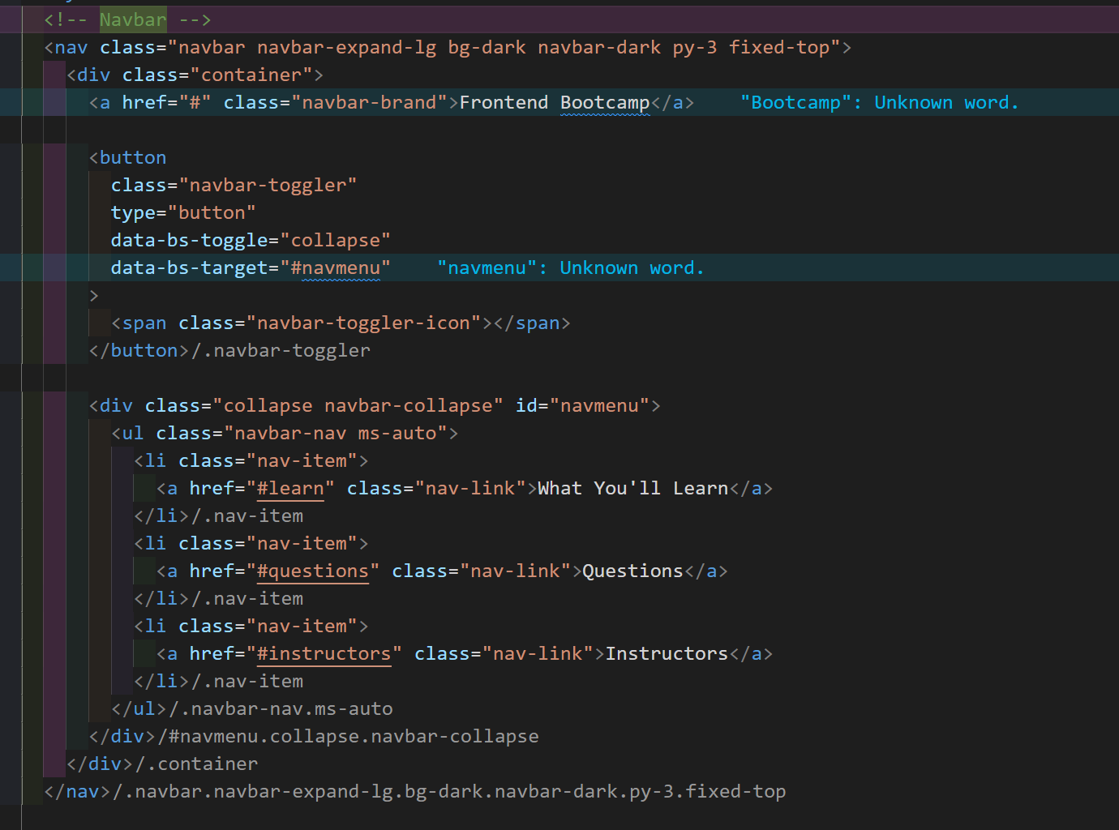
FIRST SECTION : Navigation Bar

Slide 3

SECOND SECTION: ShowCase

Slide 4
